Slide 1
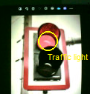
The SD-CSNN detects traffic light
Starts following procedures
The RGB pixels inside the area are counted
Yes
Stop car and wait
Red pixels > 75%?
No
Yes
Green Pixels > 75%?
Go forward

